Slide 1
Notes:
*Needs to be changed to something like: Video Insights with Azure

Slide 2
Using your Web Browser,
Open this URL:
Click on the workshop you’re attending, and find:
1
http://mlhlocal.host/lhd-resources
2
Setup Instructions
The Code Samples
A demo project
A Workshop FAQ
These Workshop Slides
More Learning Resources
Notes:
What to Say:
Tell attendees we are going to check them in for the event
Once attendees check in, they will receive an email with the items listed on the slide
Attendees must check-in to get credit for attending this event
What to Do:
Confirm that everyone has checked in by asking participants to give you a signal when they receive the email.

Slide 3

Our Mission is to Empower Hackers.
65,000+
HACKERS
12,000+
PROJECTS CREATED
3,000+
SCHOOLS
We hope you learn something awesome today!
Find more resources: http://mlh.io/
Notes:
What to Say:
Major League Hacking (MLH) events are meant to bring hackers together so they can learn, build, and share.
Give participants a brief overview of Major League Hacking (MLH).
Tell participants they can learn more at http://mlh.io/
Example Talking Points:
TODO
Through Localhost MLH is rethinking technology education to reflect how hackers actually learn and how fast the industry moves.
Here's some quick facts about MLH:
Each year, MLH supports over 65,000 hackers around the world at events they facilitate
Those students create more than 12,000 amazing projects together
MLH is a global organization that empowers hackers in more than 400 cities and growing every day

Slide 4
What will you learn today?
1
You will learn about Video Indexer APIs
2
You will analyze videos and extract insights
3
You will build an app to make your indexed content searchable

Slide 6
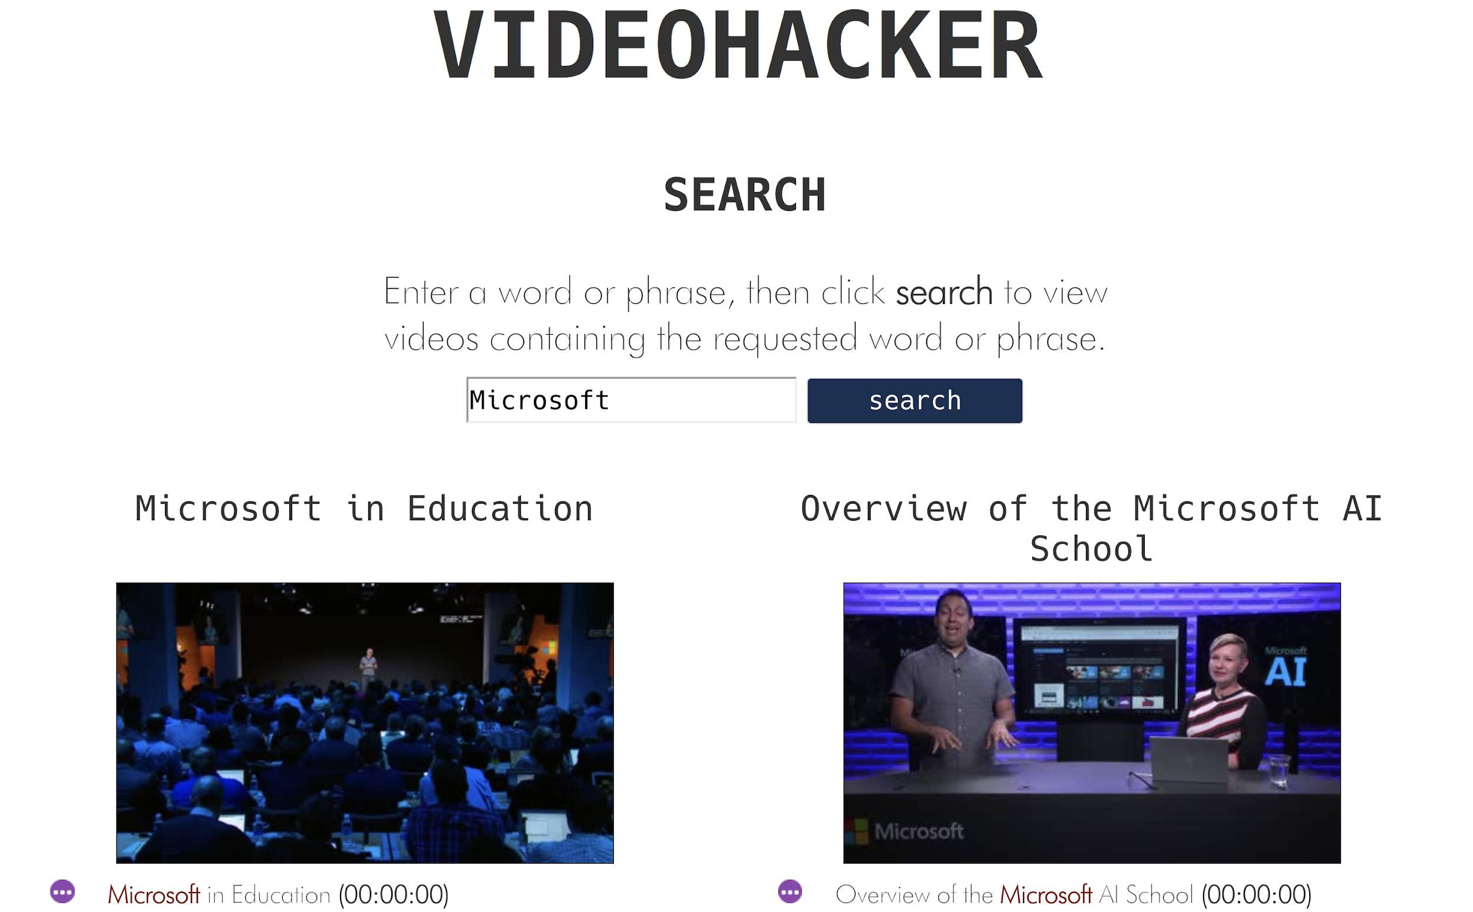
What You'll Be Building
VideoHacker is an app that allows users to search for videos matching specific keywords. How does it do this?

Slide 7

How You'll Build It
We'll be using several tools to make building this app super easy.
Node.js and Express.js - these area JavaScript tools that handle requests and responses
VideoIndexer.ai - a Microsoft Azure tool that analysis videos
The Video Indexer API - a tool that allows web apps to make requests to the Video Indexer

Slide 8

How It Works
Several things happen when users interact with our app.
The user types their search term into the box.
The app sends a request using the Video Indexer API.
The API will return the videos that match our search. Note that it doesn't only match by title - the Video Indexer transcribes the videos and tags them, so the API can search for any word spoken in the video, etc. More on this later!
The app then displays these videos the user.

Slide 9

What You're Going To Do
There's a lot of steps! Once we finish this intro, you lead yourself through this workshop, but we're around to help!
Make a Microsoft Azure account
Learn about VideoIndexer.ai and upload some videos
Interact with the Video Indexer tools
Create a subscription to the Video Indexer API so you can request information from the Video Indexer
Set Visual Studio Code and Node.js
Download the code for the app.
Add your account information to the app.
Test your app locally!

Slide 10
Great! Make sure you opened the slides in your email.
From here, this workshop is self-directed!

Slide 11

Key Advantages of
Microsoft Azure is a cloud platform with more than 100 services and tools for developers.
95% of the Fortune 500 companies run on Azure (and learning these skills can help you land your first job!)
Easily deploy Web Apps, Mobile Apps, Databases, Data Science and AI Apps, Blockchain, Analytics with pre-built configurations
Supports a wide range of
Open source libraries (Node, .NET core, spark, hadoop, kafka)
Programming languages (Python, C#, JavaScript, Java, Ruby)
Operating systems (iOS, Android, Windows, MacOS, Linux)

Slide 12
Please Note: We recommend completing this entire workshop in an Incognito Window in Chrome.

Slide 13


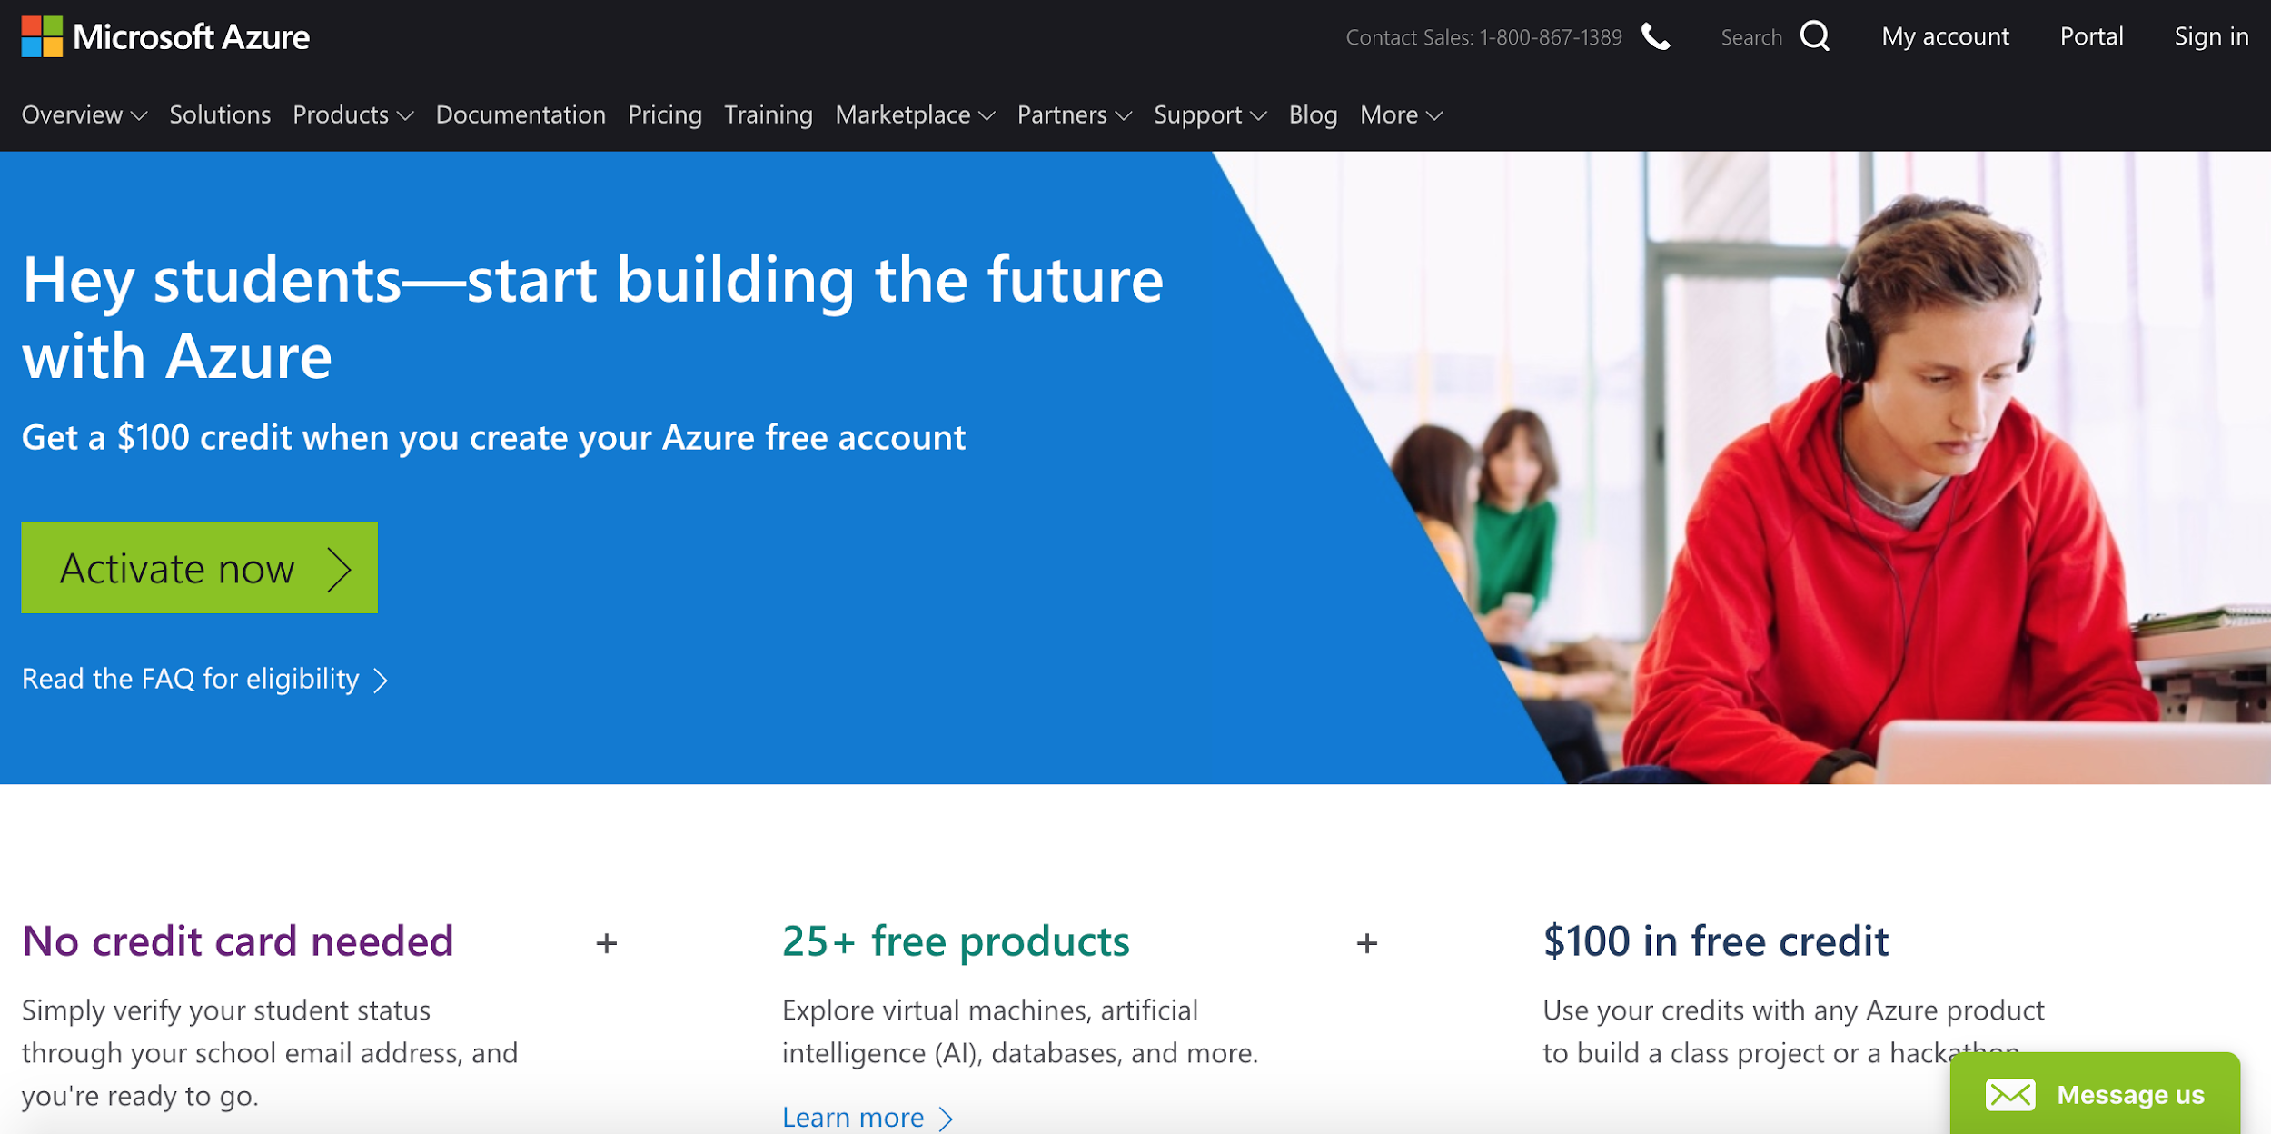
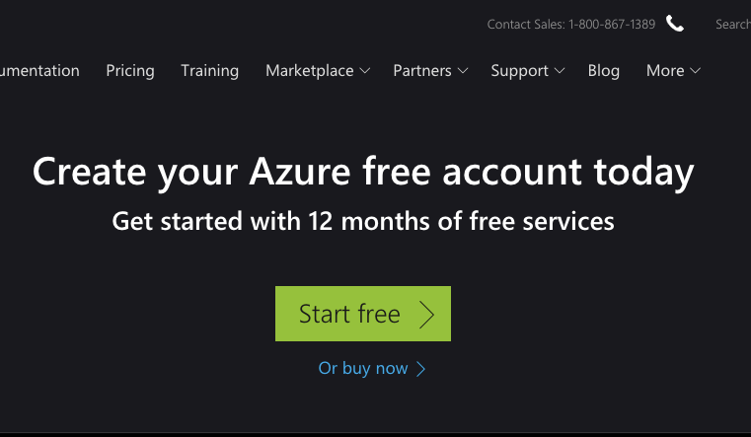
Create Microsoft Azure Account
http://mlhlocal.host/azure-student
http://mlhlocal.host/azure-nonstudent
Navigate to the top URL if you have a student email address and the bottom one if you don't. Select or .

Slide 14
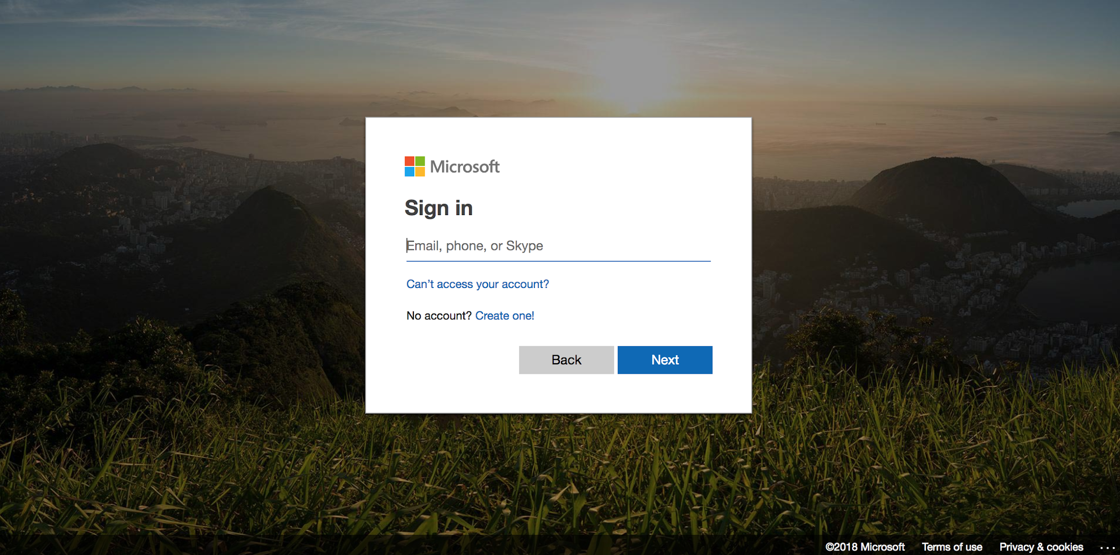
Create Microsoft Azure Account
Log in (or Sign up) with a Microsoft account

Slide 15
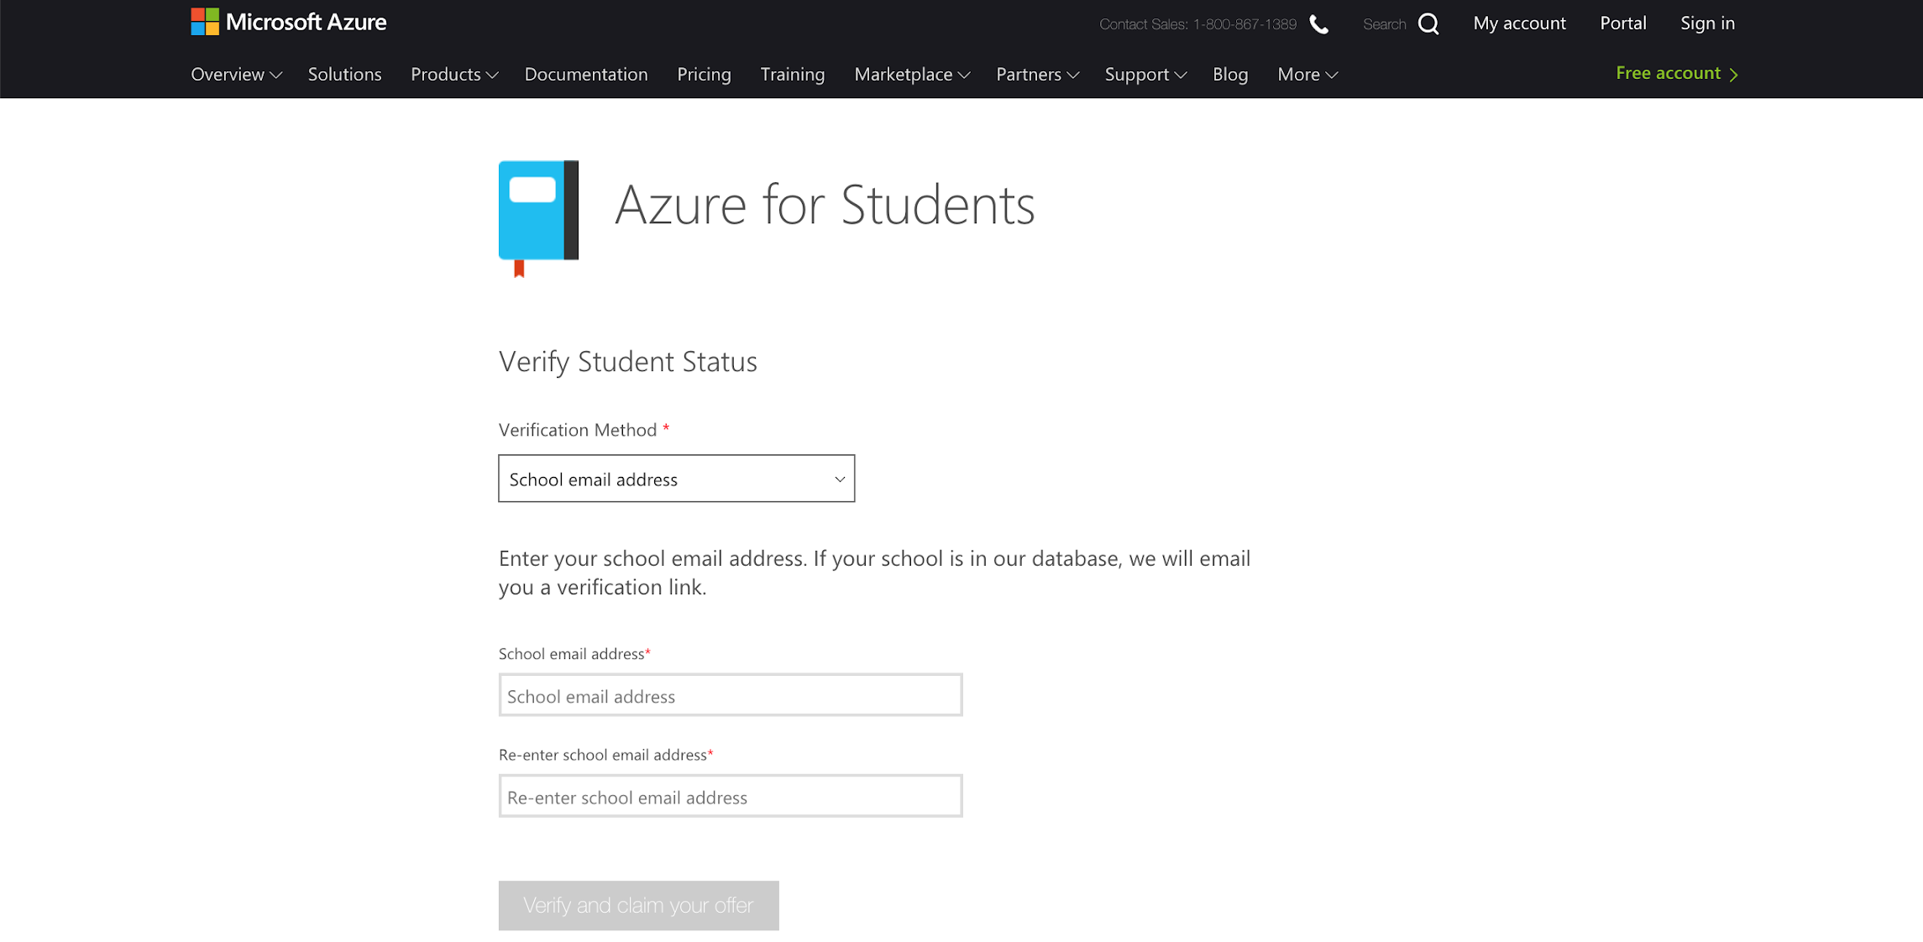
Create Microsoft Azure Account
Enter your school email address (ending in .edu), then follow the verification URL in the email sent to that address.
Choose school email address
Enter school email address

Slide 16
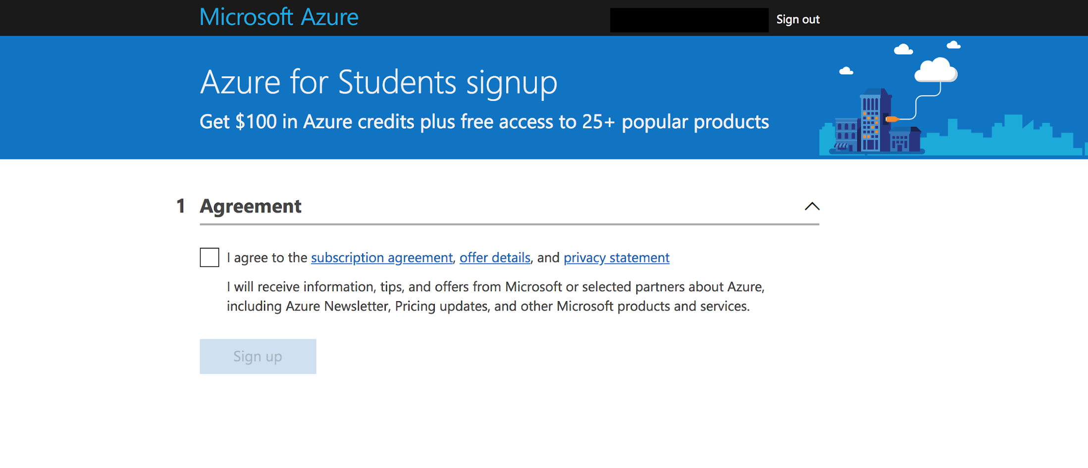
Create Microsoft Azure Account
Accept the terms of service and start using Microsoft Azure!

Slide 17
Microsoft Azure is a cloud platform with awesome developer tools.
However, we're not going to write our code on Azure; that's what Visual Studio Code is for!

Slide 19
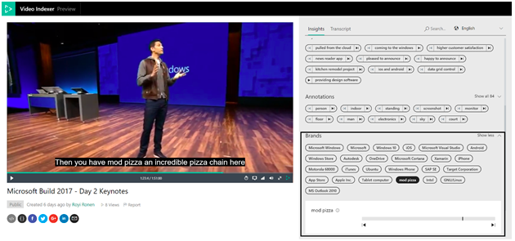
Why Use Video Indexers?
Easily Create Intelligent Apps
Make content more discoverable
Improve Engagement
Trigger Workflows and Automate Tasks
Notes:
Video indexers cut down on manual indexing, without needing to understand code. You can also use Artificial Intelligence and embed widgets to get specific analysis on your video, as well as extract metadata to create deeper engagement experiences with recommendations. As well, when the Video Indexer detects specific words, you can set up specific tasks to automate workflows.

Slide 20

Getting Started
http://mlhlocal.host/azure-video-indexer
Notes:
Head to the link above to get started. In this section, participants will index three short videos by Microsoft. Participants can also use videos of their own later. To begin, Select GET STARTED.

Slide 21
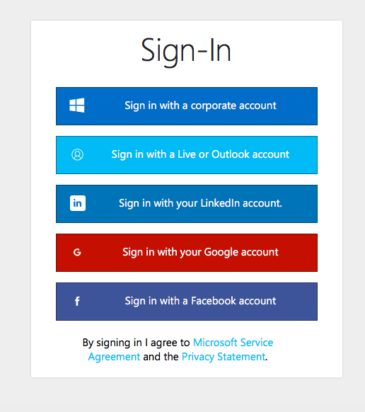
Setting Up
Sign In to the Video Indexer portal using your Corporate Account.
Notes:
While it is possible to use your Facebook or LinkedIn accounts, for this exercise participants should use their corporate account. When asked whether the app can use participants’ data, they should select Yes when prompted to do so.

Slide 22
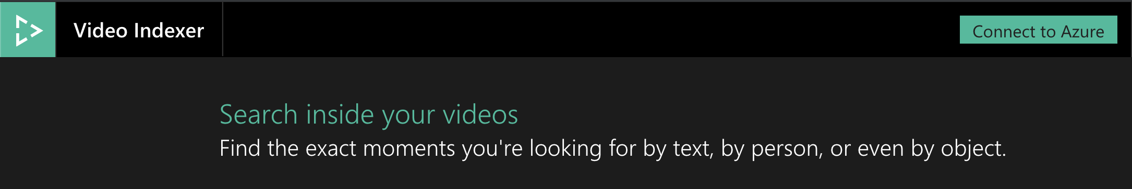
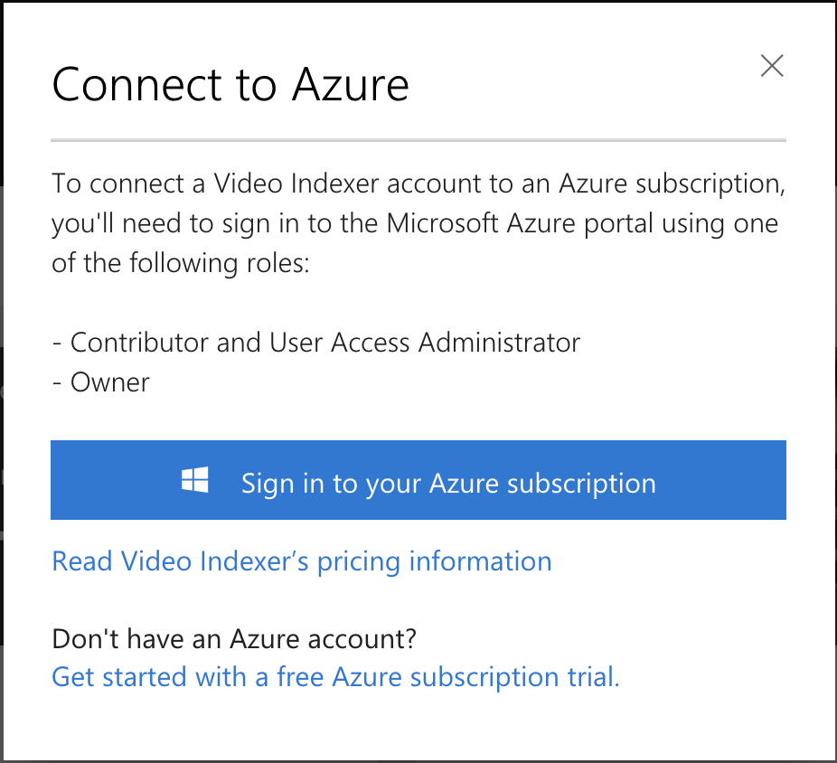
Upload Video 1 to Indexer
Select Connect to Azure.
Sign in to your Azure subscription.
Notes:
This will start the upload

Slide 23
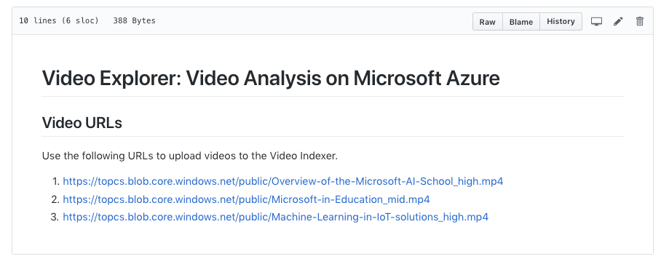
Cheat Sheet
http://mlhlocal.host/azure-video-urls
In this workshop, you'll need several URLs. Navigate to the URL above to find a cheat sheet with the URLs!
Notes:
While it is possible to use your Facebook or LinkedIn accounts, for this exercise participants should use their Microsoft account. When asked whether the app can use participants’ data, they should select Yes when prompted to do so.

Slide 24
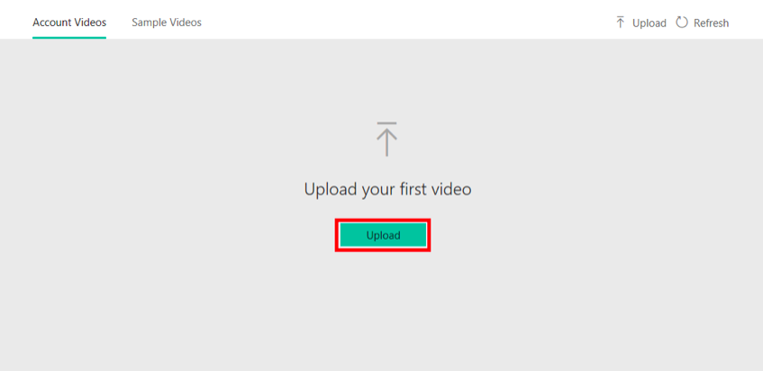
Upload Video 1 to Indexer
Back in the Video Indexer, click the Upload Button. Then click Enter File URL.

Slide 25
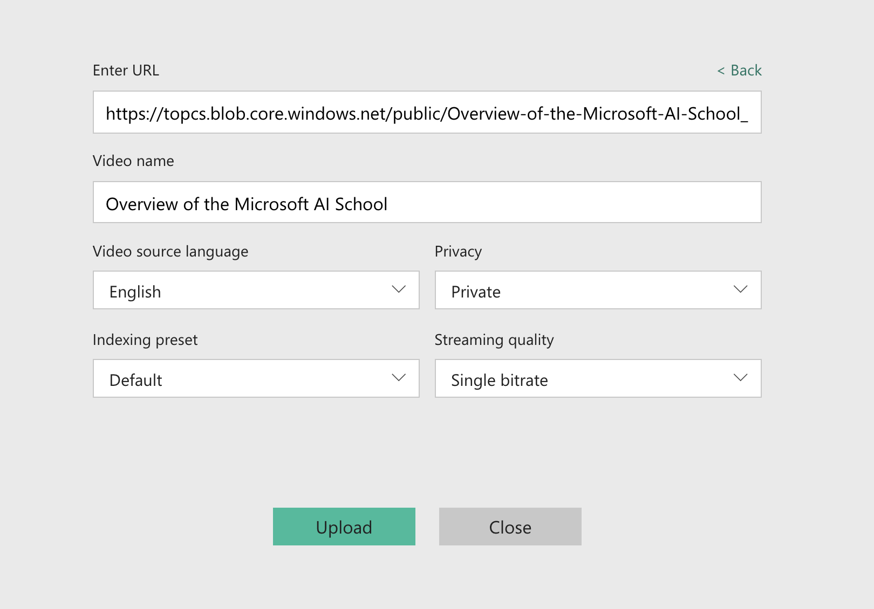
Upload Video 1 to Indexer
Paste the first URL from the cheat sheet into the field.
Set “Overview of Microsoft AI School” as the Video Name.
Leave the default settings and click Upload.
Notes:
This will start the upload

Slide 26
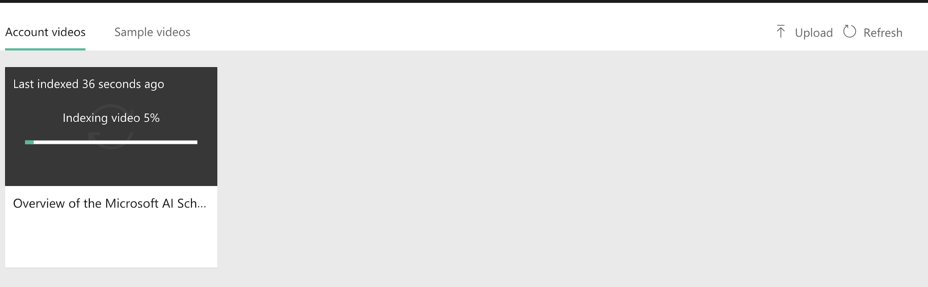
Upload Video 1 to Indexer
While the first video is processing, add the next video using the second URL from the cheat sheet. Name that one Microsoft in Education.
Follow the same process for the 3rd video. Name it Machine Learning in IoT.
Notes:
This will start the upload

Slide 27
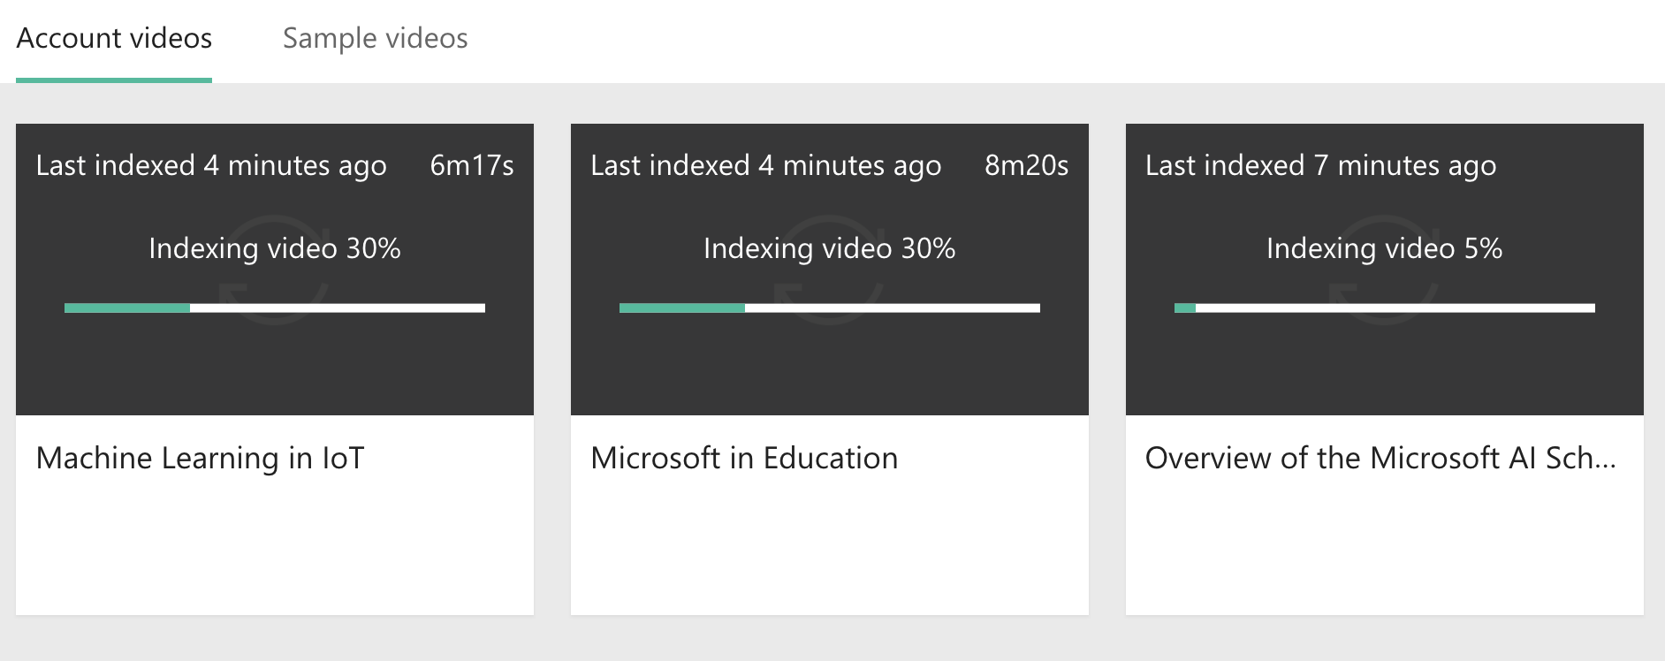
What's Happening?
We've uploaded 3 videos to the Video Indexer Tool. But what's it doing?
Video Indexer uses AI to extract insights from your videos
It transcribes speech
It identifies people when possible
It adds tags to your videos
And many other things!
Notes:
This will start the upload

Slide 28
That's going to take about 10 minutes, especially as several people are doing the same thing right now.
Let's download Visual Studio Code, an awesome development environment from Microsoft, while we wait.

Slide 29

Key Advantages of Visual Studio Code
Visual Studio Code is a simple, code-centric integrated development environment (IDE).
Available for Mac, Linux, and Windows
Key features include debugging, version control with Git, and intelligent code completion
Supports 36 programming languages and offers customized tools and plug-ins to make your dev environment your own!

Slide 30
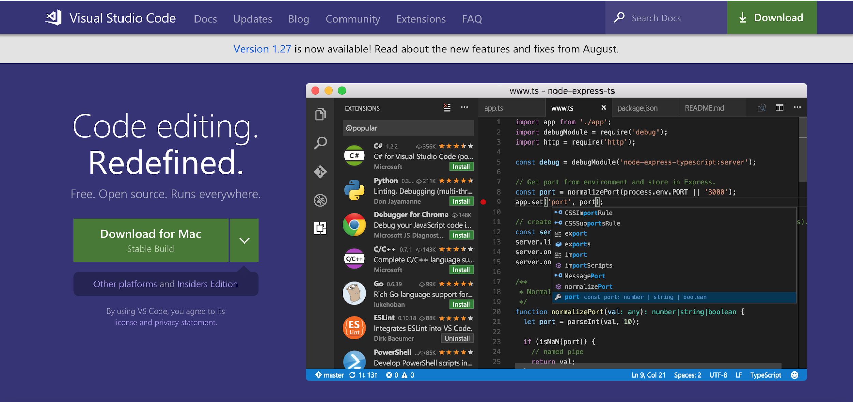
Download Visual Studio Code
http://mlhlocal.host/vscode
Follow the URL and select Download.

Slide 31
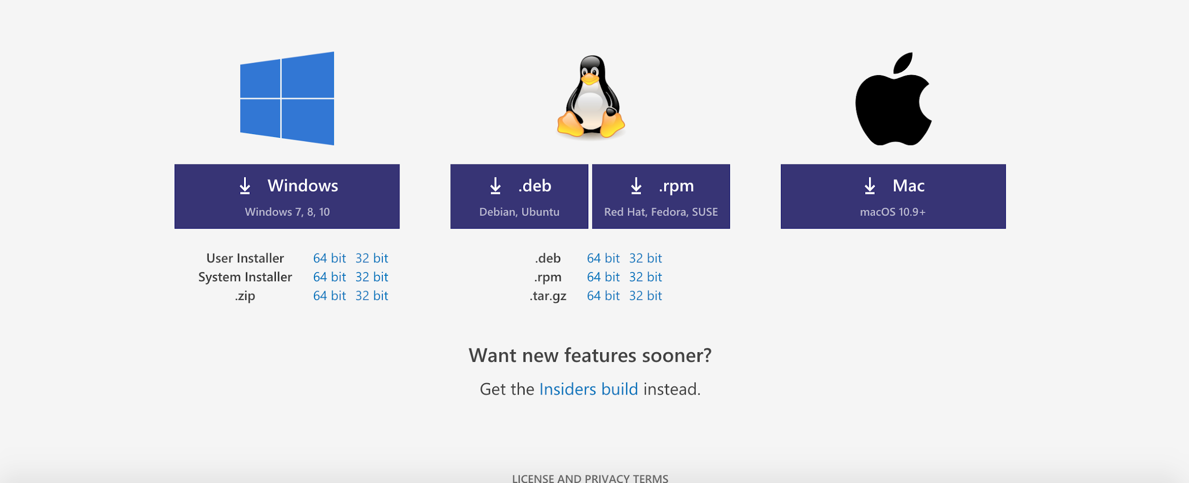
Download Visual Studio Code
(If you're having trouble, scroll to the bottom of the page and manually select the correct package for your system)
For PC
For Mac

Slide 32
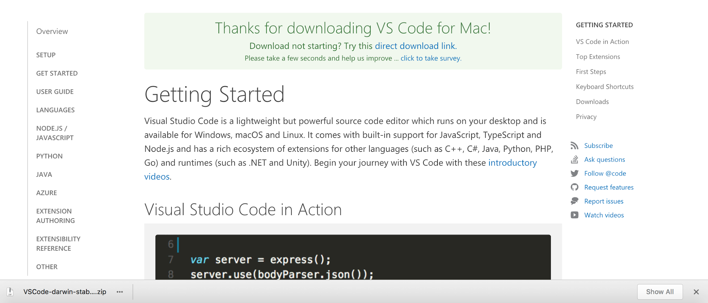
Download Visual Studio Code
Open the VSCode .zip file after it has finished downloading to set up Visual Studio Code.
Your browser may let you open the file directly from the download page...
...or you may have to open your Downloads folder and select the .zip file:

Slide 33
We're going to use Visual Studio Code later in this workshop. The app that we're going to build is a Node.js app. If you don't already have it, you'll install Node.js in the next few slides.

Slide 34

Hello, Node.js!
Remember from earlier that HackerLog is a Node app. What's Node?
Node.js is server-side JavaScript allowing us to create applications that send and receive information. You get to use the same language on the front-end and back-end!
Node.js is designed to quickly deal with multiple tasks (for example, receiving messages, updating databases, processing data) simultaneously.
It's open-source with thousands of packages available for use!

Slide 35
Install Node
Navigate to the URL that suits your computer and follow the installation instructions:
http://mlhlocal.host/node-mac
Download for Mac
http://mlhlocal.host/node-pc
Download for PC
http://mlhlocal.host/node-linux
Download Page to Select Linux Version
Notes:
What to Say:
Read the slide.
What to Do:
Recommend that they use the stable version if you are asked.

Slide 36
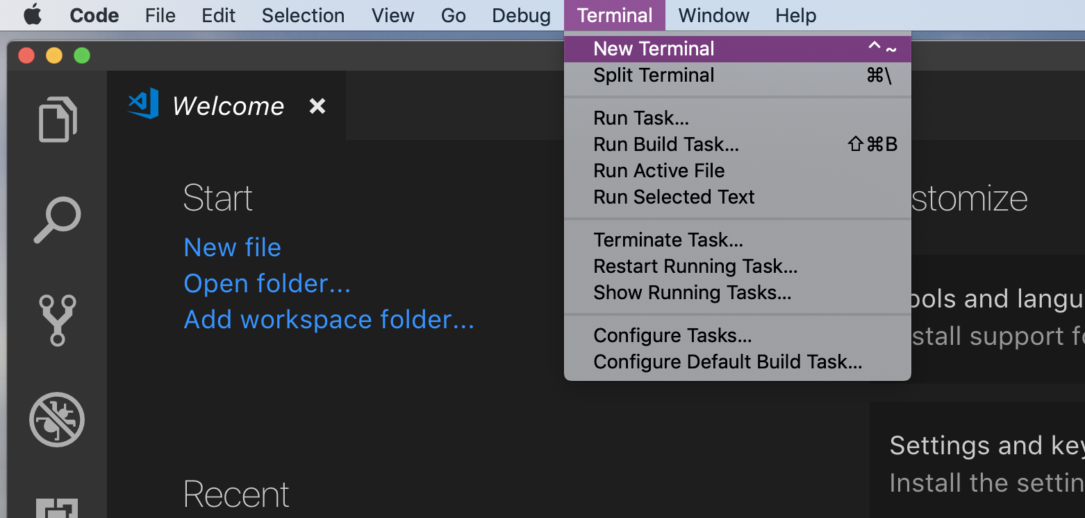
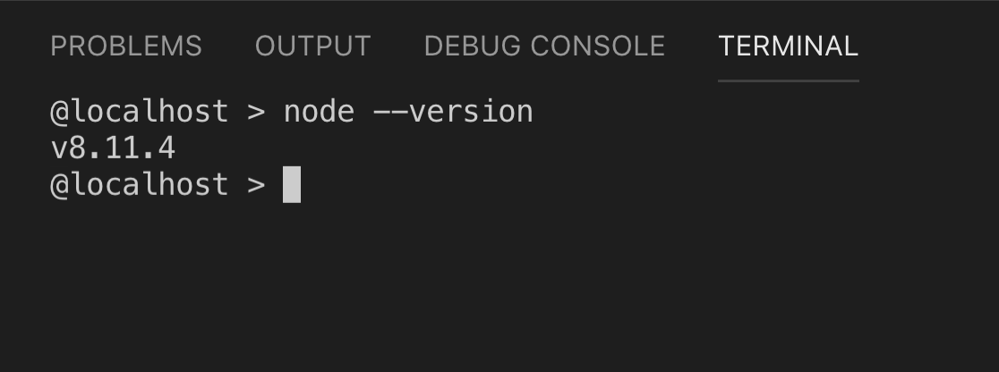
Check Node.js Installation
Open Visual Studio Code
Select Terminal -> New Terminal.
Type node --version in your terminal.

Slide 37
Great! By now your videos should be indexed. Let's explore!

Slide 39
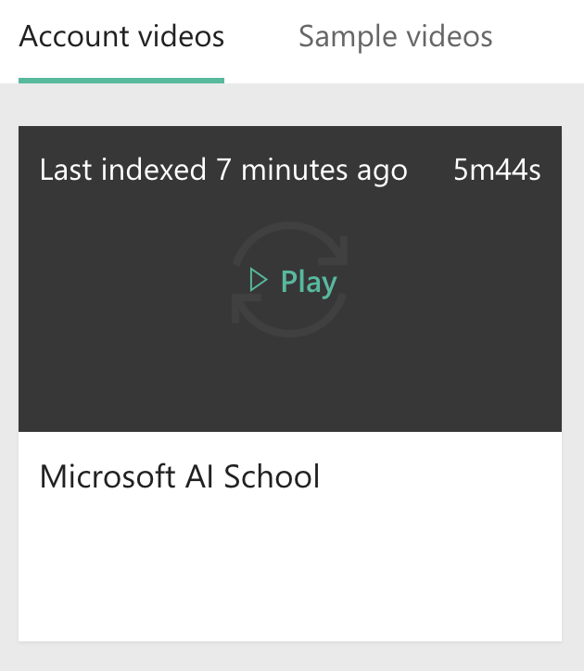
Explore An Indexed Video
Make sure your computer is muted!!
Click Play on the Microsoft AI School video.
Notes:
The Video Indexer aggregates data from the video, such as faces that appear in the video, the duration those faces are on camera, and the percentage those faces are shown versus other faces. The Video Indexer can automatically cross-index databases of famous people and identify them.

Slide 40
Troubleshooting:
If one of your videos fails to index, DELETE it and reupload it.

Slide 41
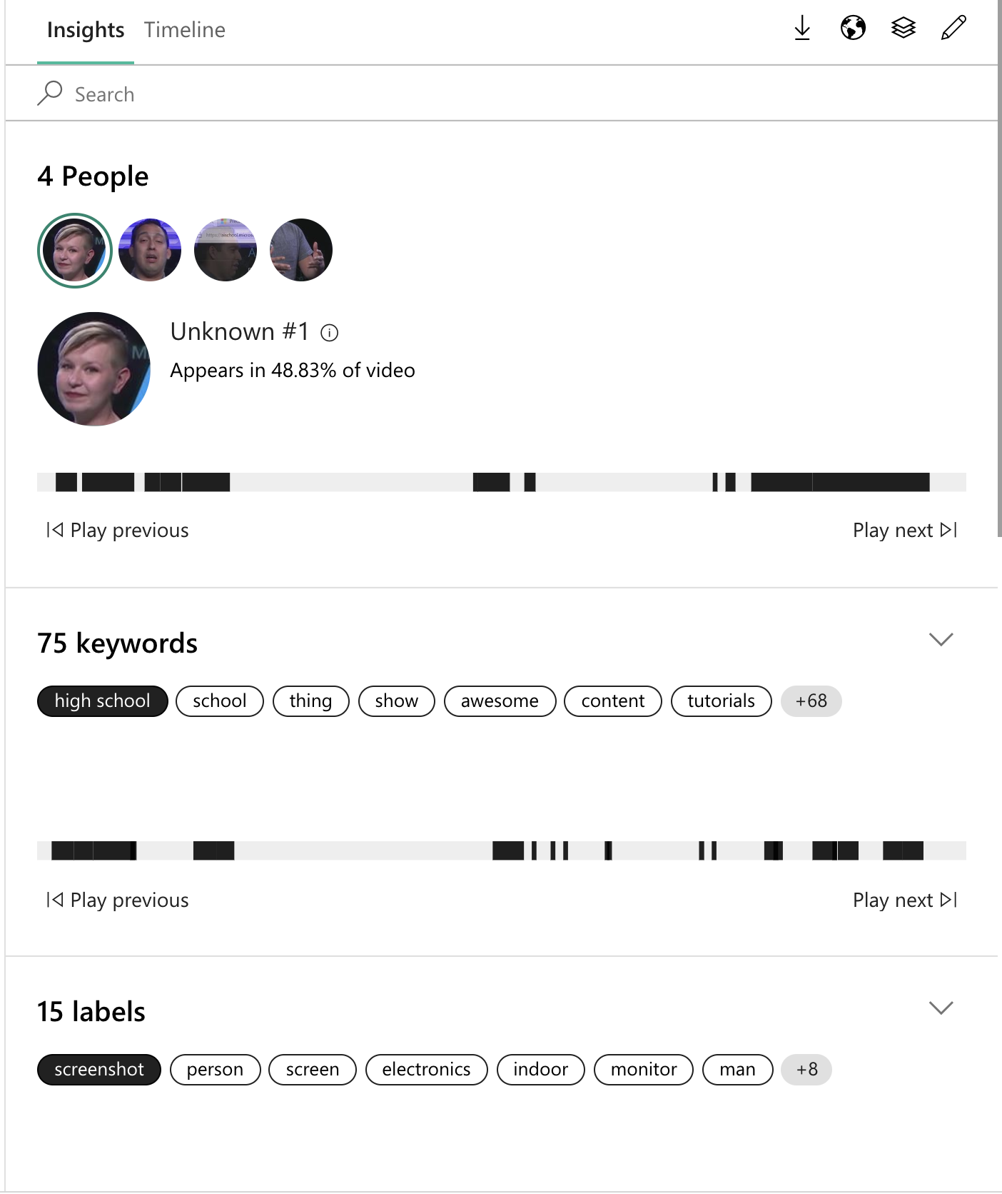
Explore An Indexed Video
Go to the Insights tab to explore Faces seen in the video and numbers of time each face was seen.
In the upper right hand corner, click the pencil icon to toggle on Edit mode.
Notes:
The Video Indexer aggregates data from the video, such as faces that appear in the video, the duration those faces are on camera, and the percentage those faces are shown versus other faces. The Video Indexer can automatically cross-index databases of famous people and identify them.

Slide 42
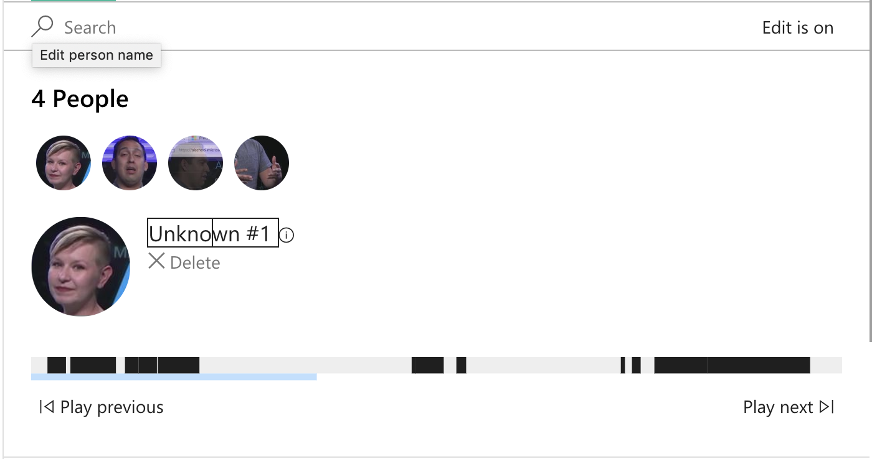
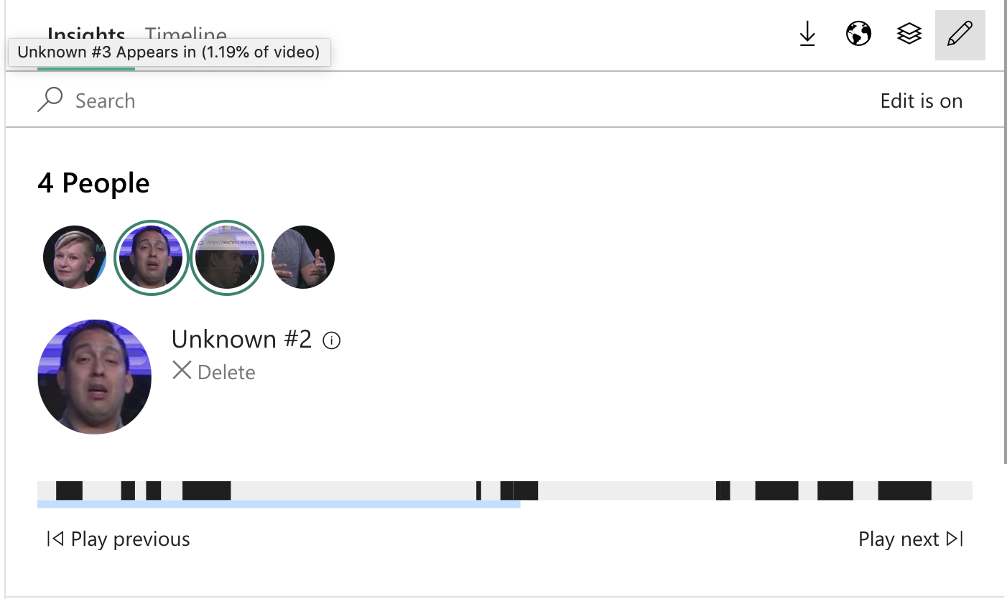
Explore An Indexed Video
Click Unknown #1.
Rename this person Sonya Koptyev. Be sure to click the check mark to save your changes.
Repeat for the other person in the video. His name is Seth Juarez. Be sure to click the check mark to save your changes.
Notes:
Repeat this step for the gentleman in the video. His name is “Seth Juarez.”

Slide 43
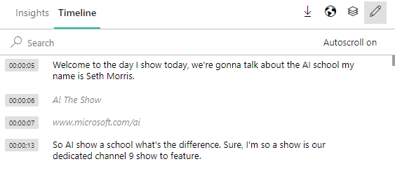
Explore An Indexed Video
Click Transcript at the top of the page to see a full transcript of the “Microsoft in AI” video
Change the misspelled word “Morris” to “Juarez” and change “sohei shouyi” to “So AI show AI”
Notes:
Video Indexer uses a deep neural network to aid in converting speech to text. However, this speech to text conversion is rarely perfect. In this section, we will edit words and phrases that were not translated correctly by the AI. Give participants a few more minutes to read over the transcript. Can anyone spot other places in the code where there are typos? Ask two or three people which typos they see.

Slide 44
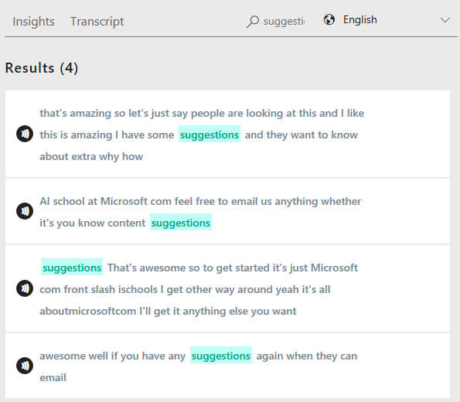
Explore An Indexed Video
Type “suggestion” into the Search bar and hit Enter.
You will see how many times in the presentation “suggestion” is said.
Notes:
Participants can also Search for the word “intelligence”. Now they will see how many times “intelligence” was both said in the presentation and was on a slide deck within the presentation. The word “intelligence” is recognized using Optical Character Recognition (OCR).

Slide 45
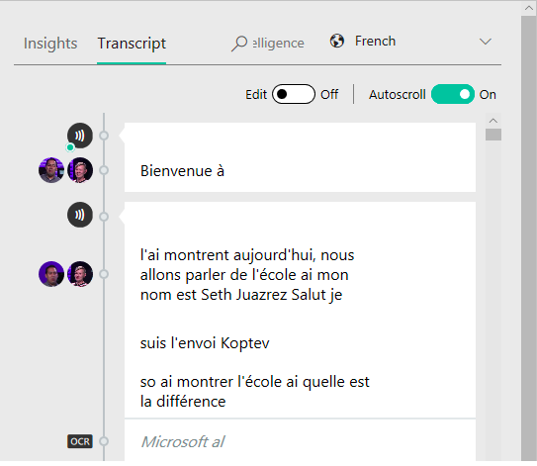
Explore An Indexed Video
Click Translate and select a language other than English to see the Video Indexer’s translation capabilities.
Notes:
The Video Indexer has the ability to translate transcripts into a variety of languages, including German, Dutch, Spanish, French, Czech, Korean, and Japanese

Slide 46
Now that you know the power of the Video Indexer tool, we're going to use the Video Indexer API to create a web app that can analyze videos!

Slide 47
Table of Contents
Introduction to Video Indexers
Index a Collection of Videos
Explore Indexed Video Insights
Create a Video Indexer API subscription
Build an app that uses Video Indexer
Review & Quiz
Next Steps

Slide 48

Create Video Indexer API Subscription
http://mlhlocal.host/indexer-api
Navigate to the URL above to open the Video Indexer Developer Portal portal.
Click Sign-In
Notes:
The real power of Video Indexer lies in the Video Indexer API, which lets you submit videos for indexing programmatically and access the results using a REST API. Enter First name and Last Name and Email used in the previous section.

Slide 49
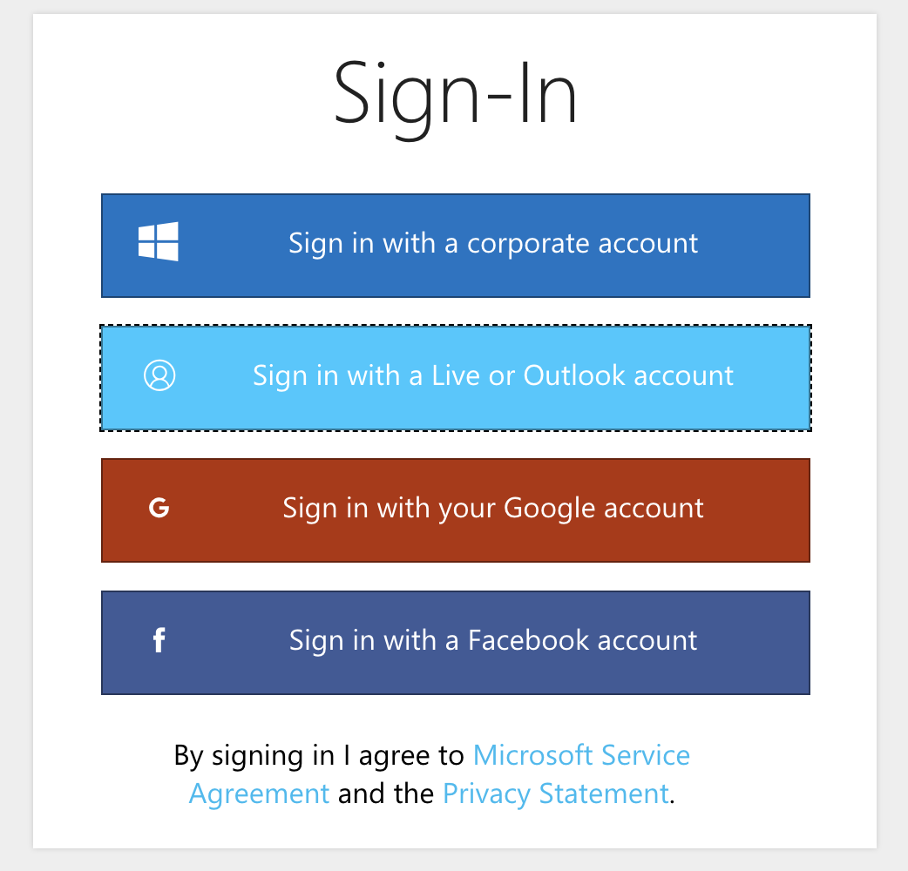
Create Video Indexer API Subscription
You MUST sign in with the Live or Outlook account you just made.
Notes:
The real power of Video Indexer lies in the Video Indexer API, which lets you submit videos for indexing programmatically and access the results using a REST API. Enter First name and Last Name and Email used in the previous section.

Slide 50
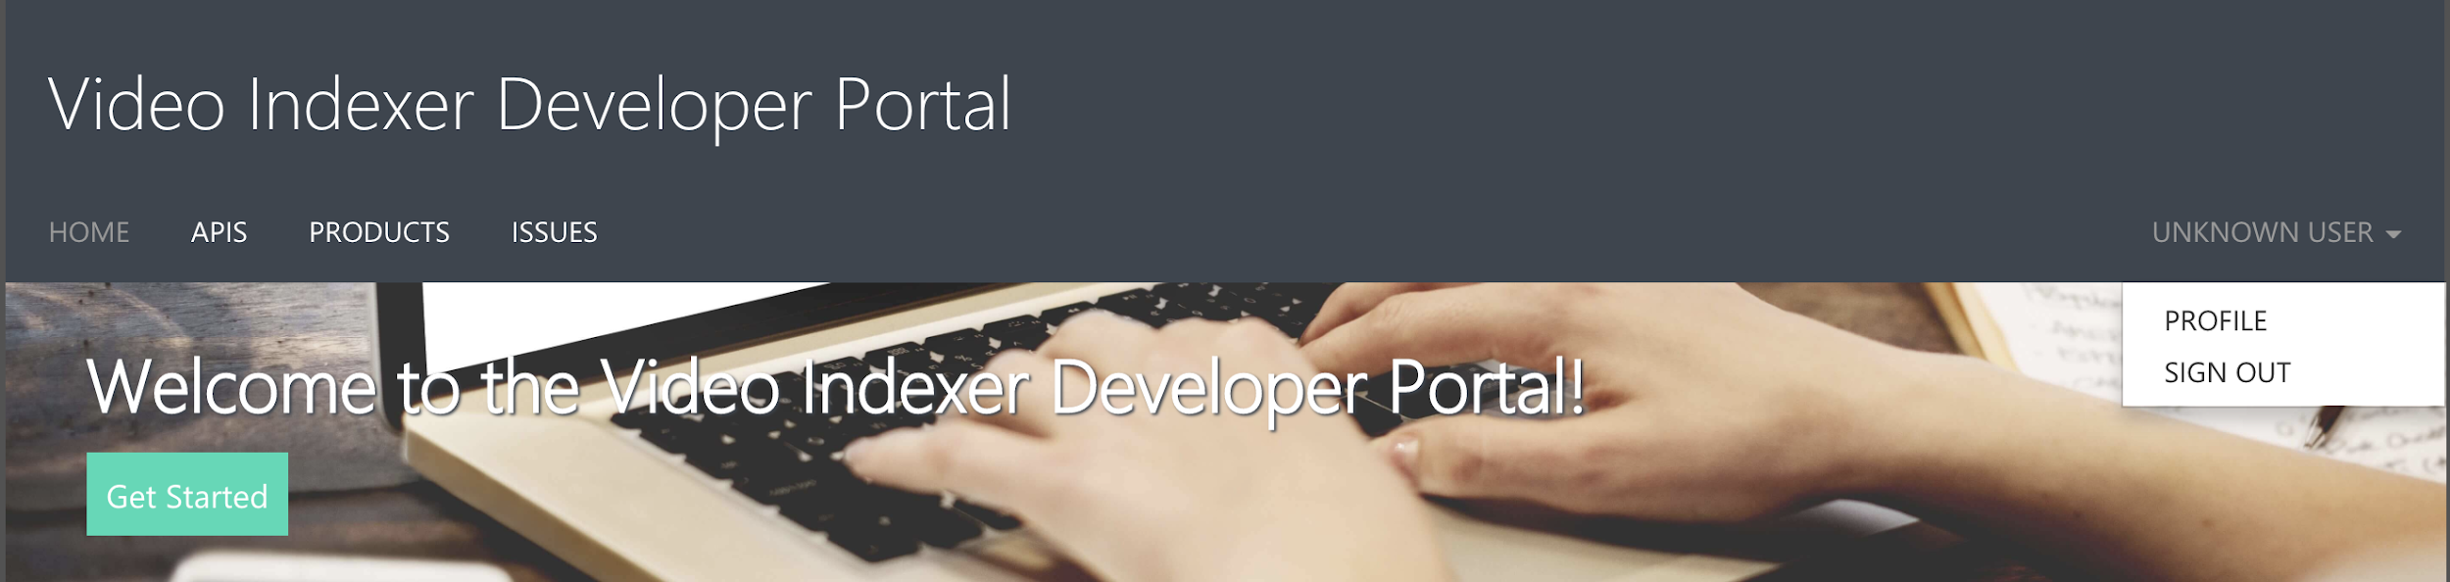
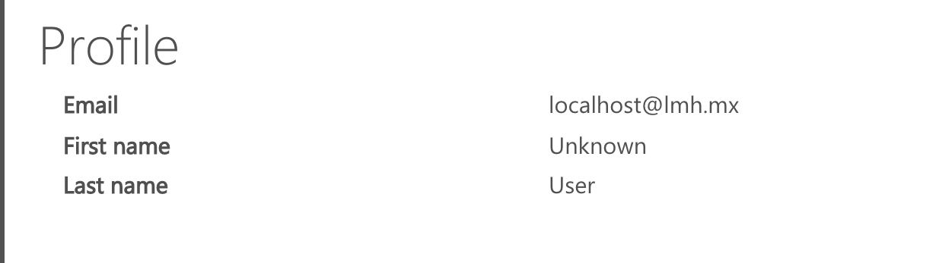
Create Video Indexer API Subscription
If you are automatically signed in, confirm your accounts match. Select your username, then Profile.
Confirm the email in your Profile matches the email you used to sign into VideoIndexer.
Notes:
The real power of Video Indexer lies in the Video Indexer API, which lets you submit videos for indexing programmatically and access the results using a REST API. Enter First name and Last Name and Email used in the previous section.

Slide 51
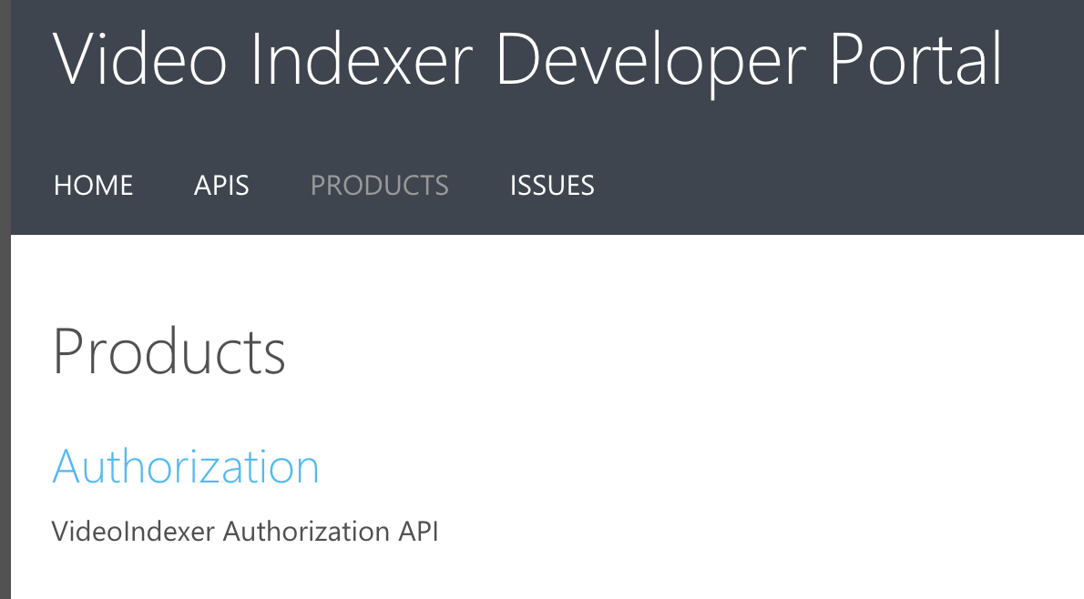
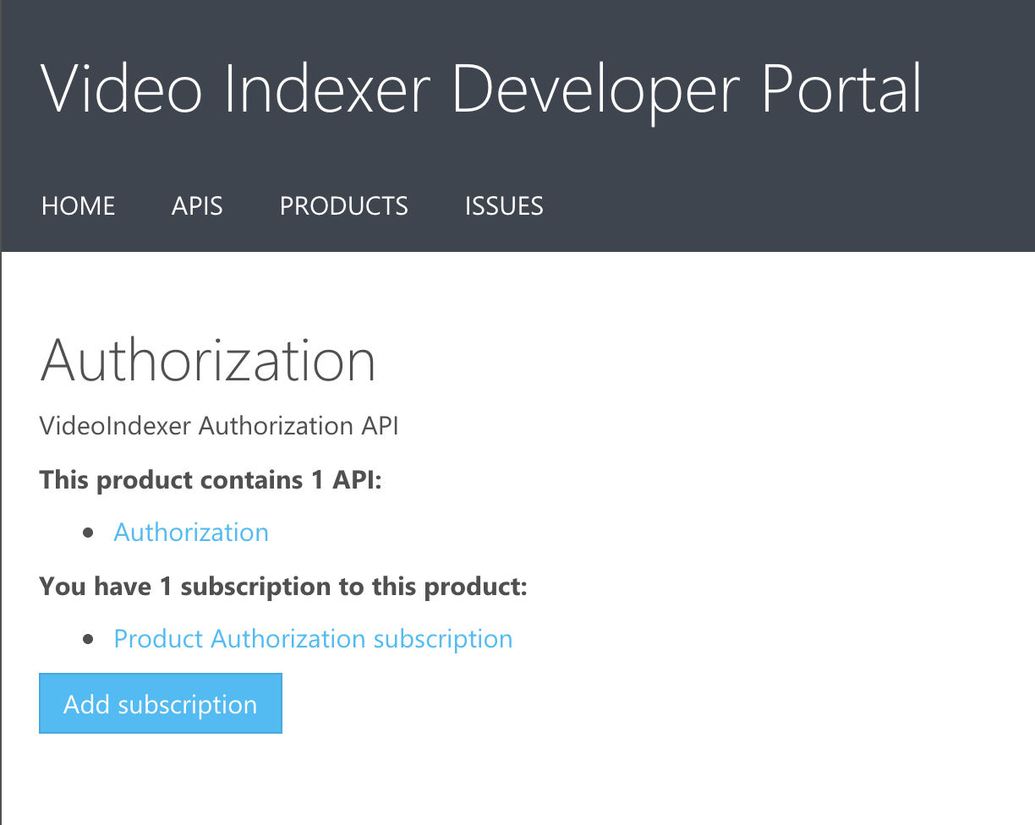
Create Video Indexer API Subscription
Now, let's get your API keys. Click Products followed by Authorization.
Select Product Authorization subscription.

Slide 52
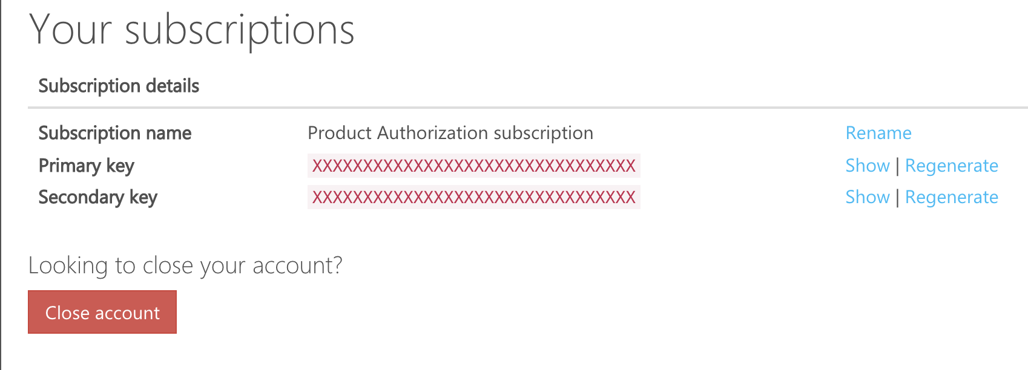
Create Video Indexer API Subscription
Click Show to the right of “Primary Key.” Copy the API key to the clipboard, then click Hide.
Notes:
Now with an API key, participants can write apps using the Video Indexer API. The API key travels in an HTTP header in each request. Without a valid API key, the Video Indexer API fails requests placed to it. It is the API's way of ensuring that the caller is authorized.

Slide 53
Why did you just copy that key?
You'll need that to add to the Video Indexer app we're about to build!

Slide 54
Table of Contents
Introduction to Video Indexers
Index a Collection of Videos
Explore Indexed Video Insights
Create a Video Indexer API subscription
Build an app that uses Video Indexer
Review & Quiz
Next Steps

Slide 55
Great! Now let's check out the code for the app.

Slide 56
Download the Video Explorer Starter Code
http://mlhlocal.host/azure-video-code
Navigate to the URL above.
A zip file of the code will be downloaded.
We need to unzip the file and open it in Visual Studio Code. These steps are different for MacOS and Windows – please follow the next steps very carefully depending on your operating system!

Slide 57
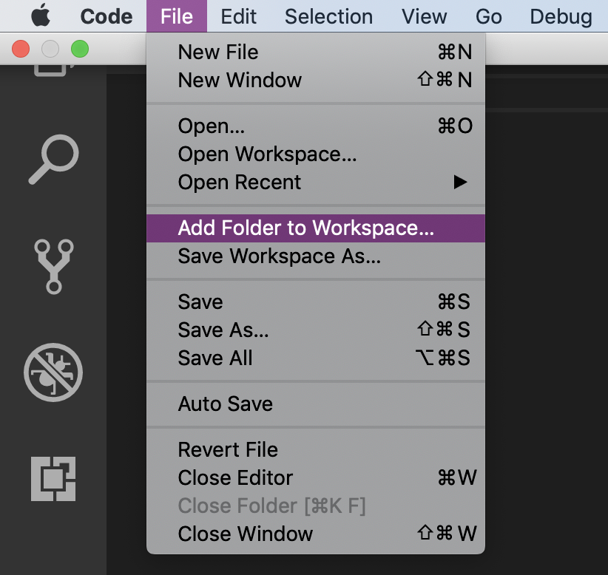
Add Project to Visual Studio Code: MacOS
Click the downloaded zip file. It will be automatically unzipped.
In Visual Studio Code, Click File -> Add Folder to Workspace.

Slide 58
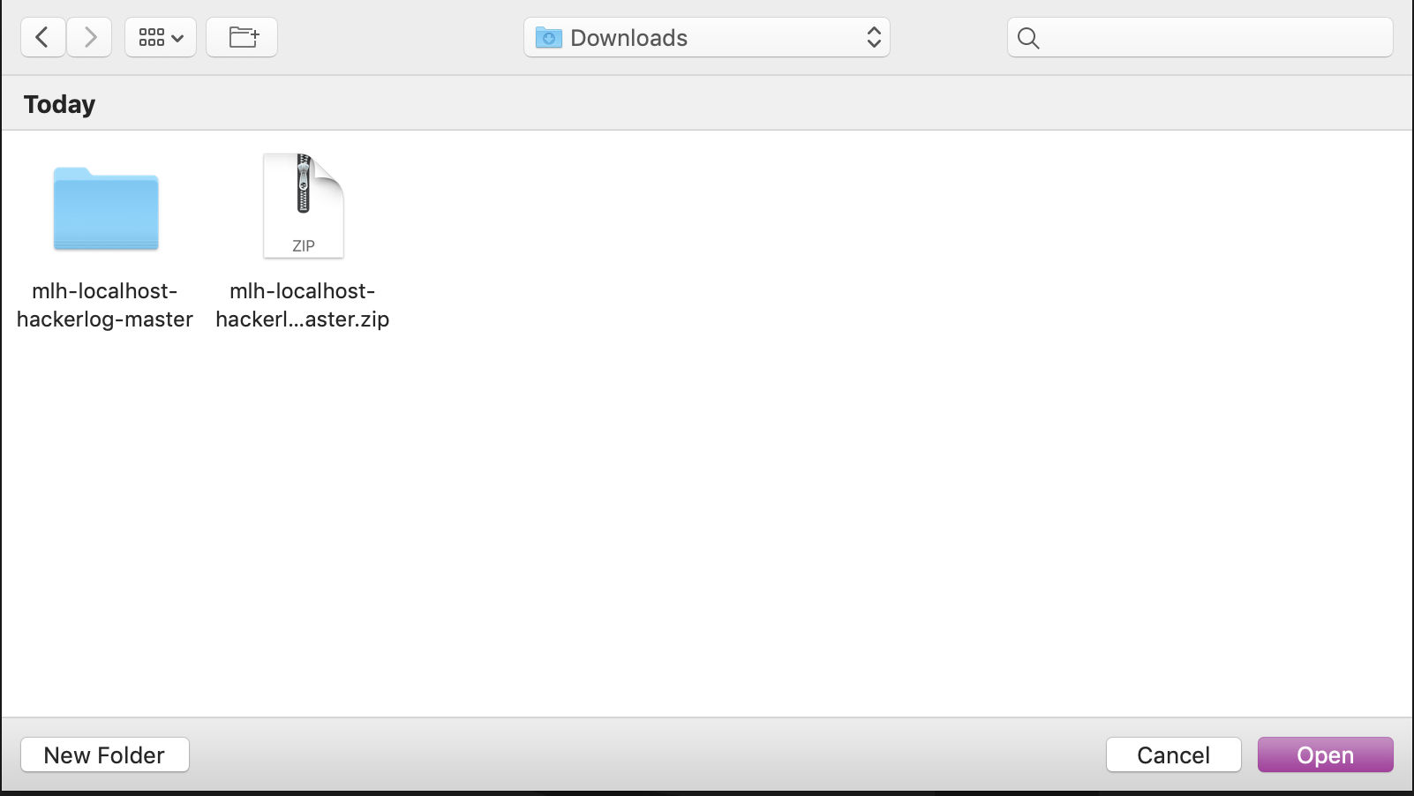
Add Project to Visual Studio Code: MacOS
In the file navigator modal, navigate to Downloads.
Click mlh-localhost-videohacker-master.
Click Add.

Slide 59
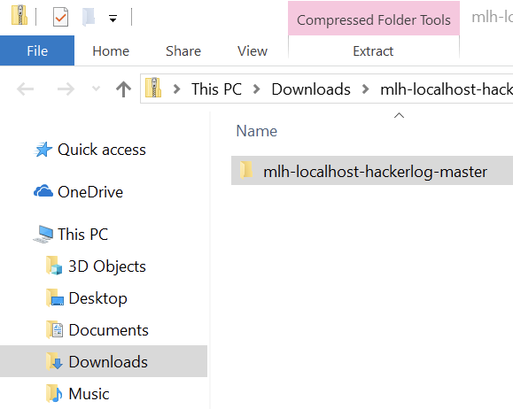
Add Project to Visual Studio Code: Windows
On a Windows computer, open the Downloads folder.
Click mlh-localhost-videohacker-master.
Click Extract at the top.
Click Extract All.

Slide 60
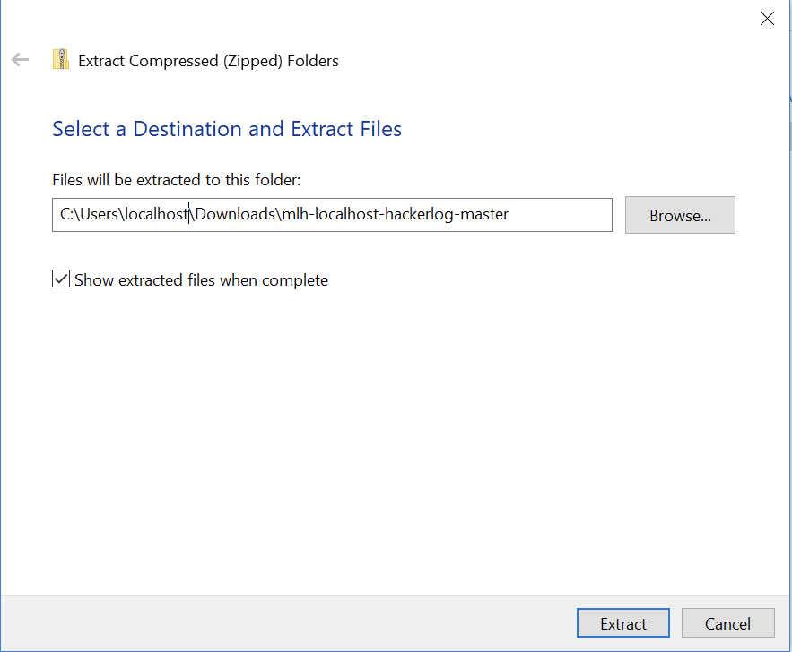
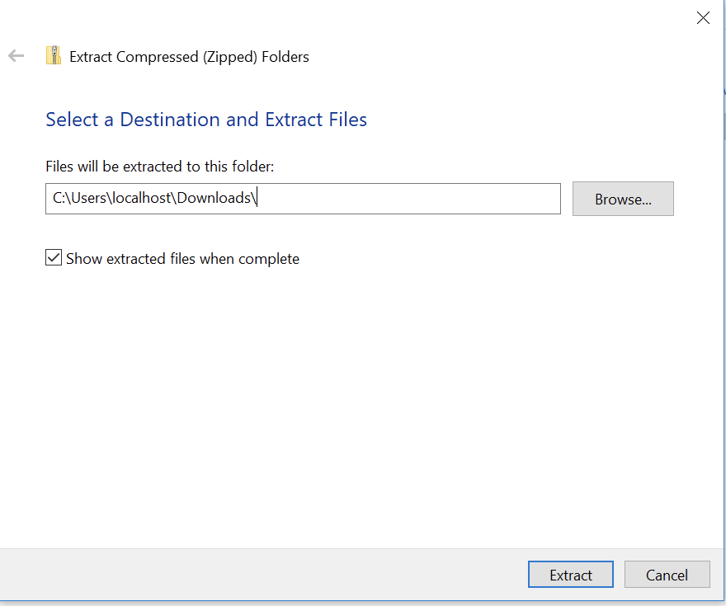
Add Project to Visual Studio Code: Windows
This screen should pop up. Delete mlh-localhost-videohacker-master. Click Extract.
In Visual Studio Code, click File -> Add Folder to Workspace.
Select this folder from your Downloads.

Slide 61
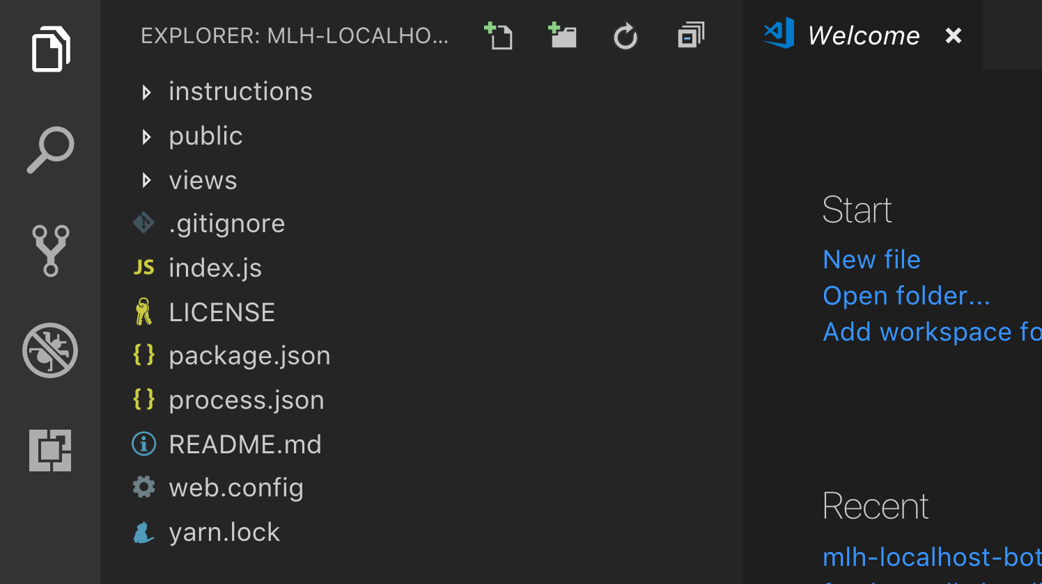
Add Project to Visual Studio Code
On both Mac and PC, Visual Studio Code looks like this:

Slide 62
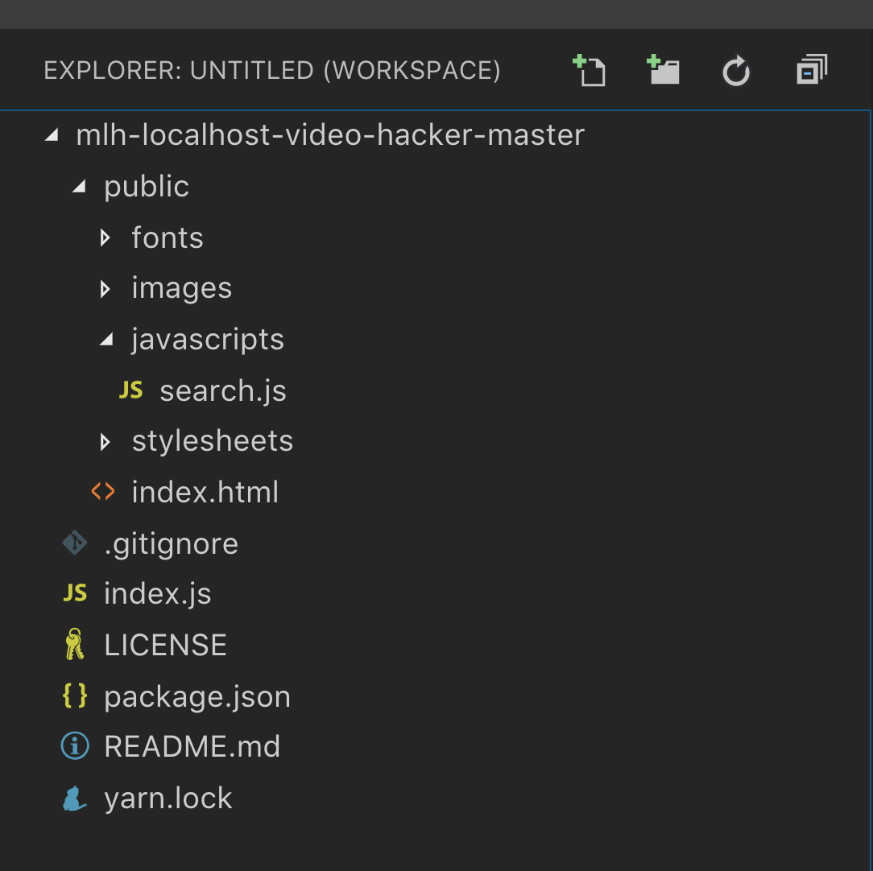
What's in this project?
public/ – this directory contains files for the browser to display your web app, such as CSS and fonts
index.js – a JavaScript file that handles the request and response cycle for our app
search.js – a JavaScript file adds the response from the Video Indexer API index.html
index.html – the page users see when they navigate to our app

Slide 63
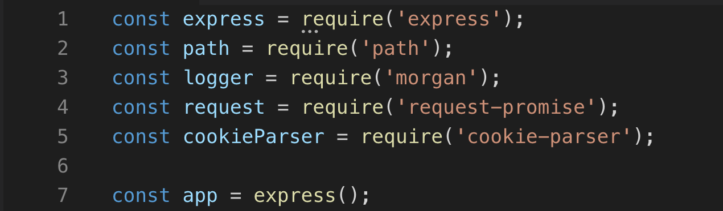
Code Review
Open index.js in Visual Studio Code and let's review!
index.js
Lines 1 - 5 allow the app to use the listed Node packages.
Line 7 creates an Express app, which will handle routing, or how the app receives and sends information

Slide 64
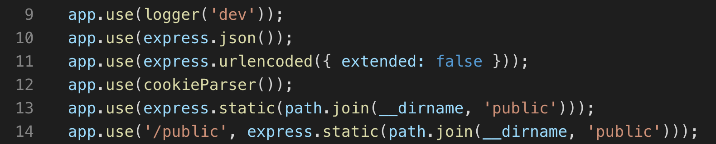
Code Review
index.js
Lines 9-14 specify settings for how we want the Express app to work.
Line 9 logs each request to your terminal so you can see what's happening as your app runs!

Slide 65
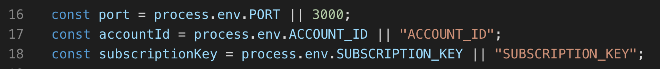
Code Review
index.js
Line 16 says which port to run the app on
Line 17 saves your account id to a variable. You'll find that later!
Line 18 saves your subscription key to a variable. You just copied that from your portal a few steps earlier.

Slide 66
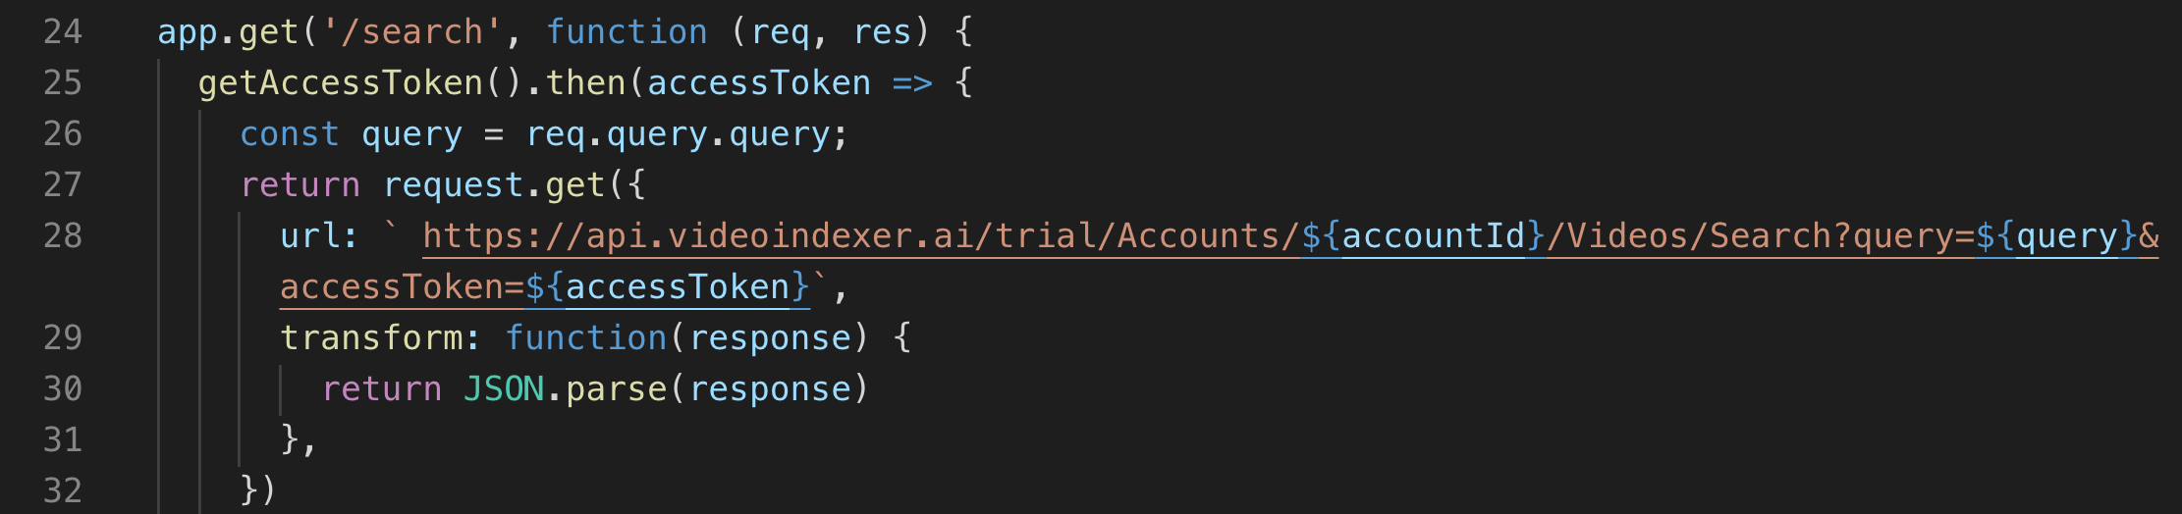
Code Review
index.js
Line 24 opens the event handler that responds when someone clicks the search button on your app
Line 25 calls the getAccessToken() function, which requests your access token from your Video Indexer Account, then it passes it to the next part of the event handler

Slide 67
Code Review
index.js
Lines 27-28 send a get request to the Video Indexer api and includes your account id, subscription id, the search query, and your access token
Lines 29-30 turn the response in JSON, which can be rendered by the browser

Slide 68
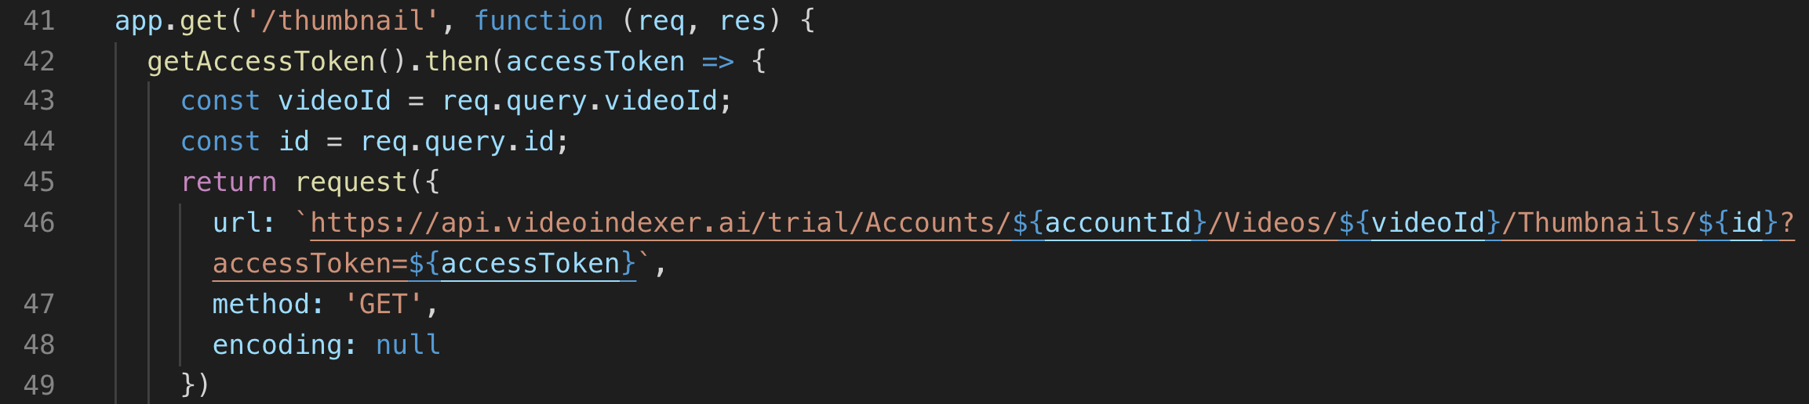
Code Review
index.js
Lines 41-49 do essentially the same thing as the previous event handler when a user clicks a video thumbnail on your app

Slide 69
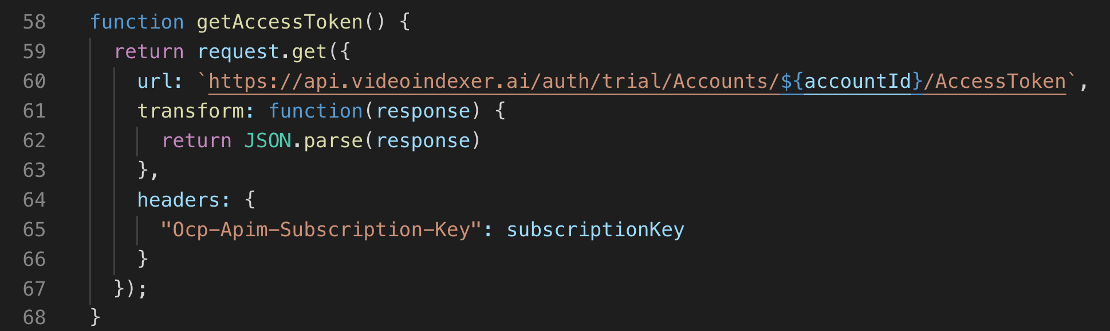
Code Review
index.js
Line 58 opens a function called getAccessToken()
Lines 59-67 set up a get request to the Video Indexer API asking for the access token for your account, turns the response into JSON, and includes your subscription key as a header (which tells the API that you're allowed to access this information)

Slide 70
Great! Now you know how the app requests and receives information from the Video Indexer API. How does the app show that information to you?

Slide 71
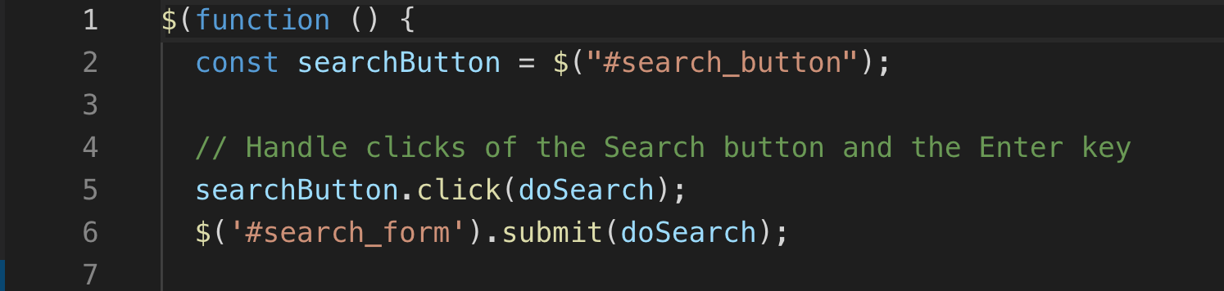
Code Review
Open search.js in Visual Studio Code and let's review!
search.js
Line 2 saves the search button from index.html as a variable
Lines 5-6 call the doSearch function when a person clicks the search button or submits the form by hitting Enter

Slide 72
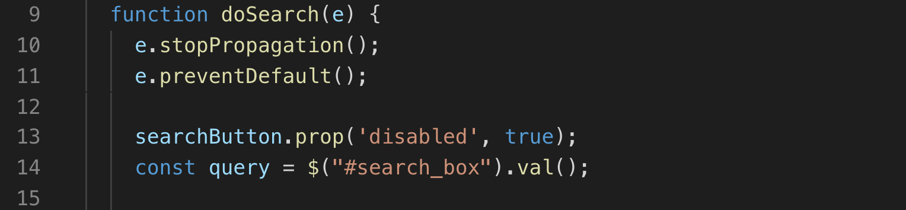
Code Review
search.js
Line 9 opens a function called doSearch that gets called when submit submits a search
Lines 13-14 stops the search button from working while the search is taking place (so that you don't submit the same request numerous times) and grabs the value that the user enters in the search box

Slide 73
Code Review
search.js
Lines 16-17 use the fetch API to send a request to the Video Indexer API, then convert the response to JSON

Slide 74
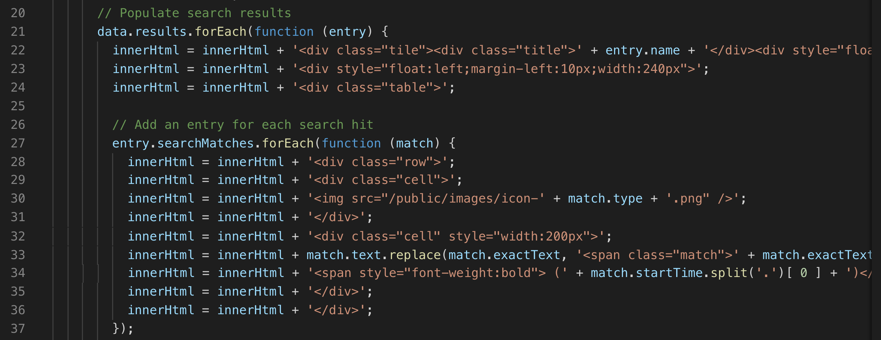
Code Review
search.js
Lines 21-27 add the response to index.html so the user can see it!

Slide 75
Great! Now you know how the app works. Let's add your information so you can test it out locally!

Slide 76
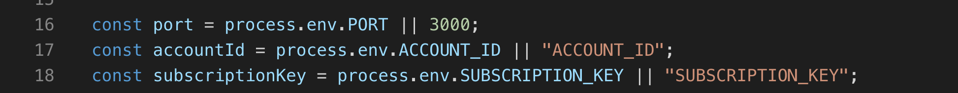
Add Your Credentials
index.js
Use the EXPLORER panel in Visual Studio code to open the file named index.js.
We need to retrieve our ACCOUNT_ID for line 17 and our SUBSCRIPTION_KEY for line 18.
When you created your Video Indexer API Subscription, you retrieved your subscription key. Go back to those steps if you don't have it.
Paste that key on line 18.

Slide 77


Add Your Credentials
We also need the account ID for this app to work.
Open the settings in the Video Indexer.
Select Account.
Copy your Account Id.

Slide 78
Add Your Credentials
index.js
Replace ACCOUNT_ID on line 17 with the API key you retrieved in the previous exercise.
Then Save.

Slide 79
Your app has everything that it needs to work! Let's test it out.

Slide 80


Test Your App!
Click index.js to open the file (even if it's already open).
Open a new terminal. Visual Studio Code will automatically open your terminal in the correct directory.
Type npm install. This will required packages.

Slide 81

Test Your App!
Type node index.js. This will tell your app to start running!
Open localhost:3000 in your browser!
Once Video Explorer starts, type “technology” into the box and click search. You should see videos where “technology” is mentioned.

Slide 82
That was amazing! Let's review.

Slide 84
Let’s recap quickly...
1
Video Indexer is a new Cognitive Service by Azure
2
The Video Indexer can translate and index video information
3
The Video Index API can programmatically index and analyze video data

Slide 85
What did you learn today?
We created a fun quiz to test your knowledge and see what you learned from this workshop.
http://mlhlocal.host/quiz

Slide 87
Keep Learning: Practice Problems for Later
Extra Practice Problem 1:
Try image indexing (Instructions in your email)
Extra Practice Problem 2:
Deploy Your App (Instructions in your email)
Notes:
What to Say:
Read the slide.
What to Do:
Encourage participants to try these problems on their own.

Slide 88

Learning shouldn't stop when the workshop ends...
Check your email for access to:
These workshop slides
Practice problems to keep learning
Deeper dives into key topics
Instructions to join the community
More opportunities from MLH!

Slide 89
v.0.0.1

